Slide 1

My Bupa
Agent
Your health, handled.
In your language.
Team 4D / Challenge 4: Data
01 / 14
Notes:
My Bupa Agent helps members understand their cover and take the next step.
Pitch timing: 5 seconds.
[Sources]
Current project presentation plan and product definition, 28 September 2026. Prototype boundaries from README.md.
Abstract background generated with the built-in imagegen tool. Prompt retained in .ppt-build/assets/blue-flow-prompt.txt.
[/Sources]

Slide 2
We are the users
01
An unfamiliar
healthcare system
Having insurance
did not make the
next step clear.
02
Cover we struggled
to understand
03
Medical conversations
in a second language
02 / 14
Notes:
We started with a question from our own experience: why can someone have health insurance and still feel unsure about getting care? We were learning a new healthcare system, trying to understand our cover, and dealing with medical language in English. We wanted to make that first step easier for someone like us.
Pitch timing: 30 seconds.
[Sources]
Current project presentation plan and product definition, 28 September 2026. Prototype boundaries from README.md.
[/Sources]

Slide 3
Cost can delay access to care
13.0%
of people aged 25–34 who needed a GP delayed
or went without a visit because of cost.
Australia, 2024–25
ABS, Patient Experiences 2024–25. National data, not specific to Bupa or international students.
03 / 14
Notes:
National data shows that cost can keep young adults from seeing a GP. In 2024–25, 13 percent of people aged 25 to 34 who needed a GP delayed or went without a visit because of cost. This gives us context. Our student research needs to establish which barriers matter most for our users.
Full-deck / Q&A detail.
[Sources]
Current project presentation plan and product definition, 28 September 2026. Prototype boundaries from README.md.
ABS Patient Experiences 2024–25, age 25–34, GP care delayed or not used due to cost: 13.0%. https://www.abs.gov.au/statistics/health/health-services/patient-experiences/2024-25
[/Sources]

Slide 4
Meet Lin
Lin
01
What does my cover include?
02
Where should I go?
24-year-old international student
New to Melbourne
Bupa OSHC member
03
Can I use my language?
04
How do I get it done?
Illustrative persona
04 / 14
Notes:
Meet Lin, a new international student in Melbourne. She needs to understand her cover, choose where to go, and communicate in her language. Then she still has to complete the booking. Our product follows her through that final step.
Pitch timing: 20 seconds.
[Sources]
Current project presentation plan and product definition, 28 September 2026. Prototype boundaries from README.md.
[/Sources]

Slide 5
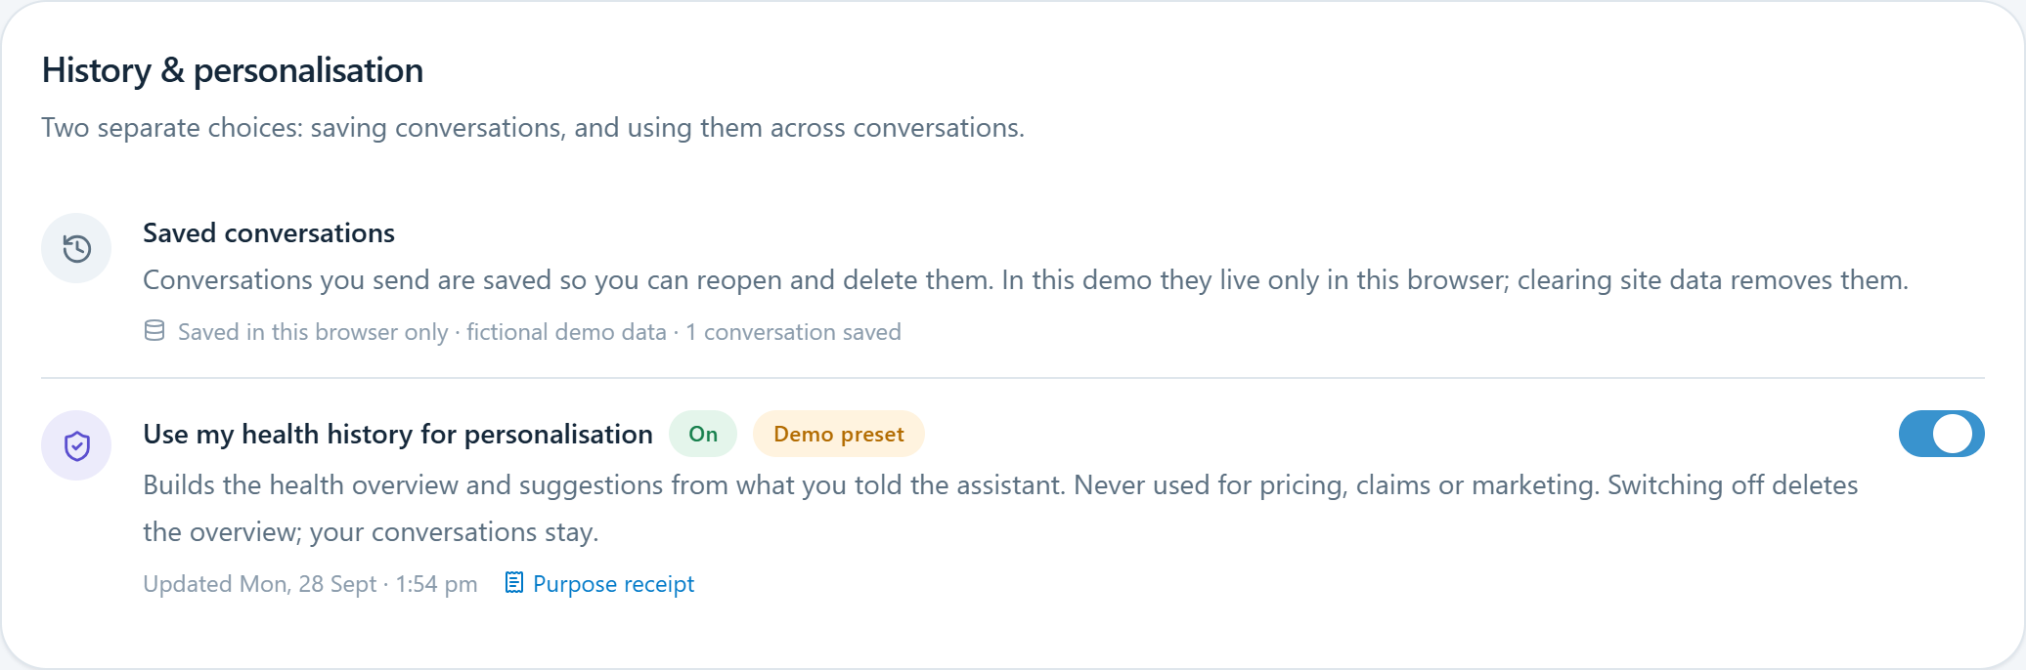
Useful help before
another data request
Start with permitted data.
Ask when it helps
the next step.
Keep the choice visible
and reversible.
Prototype permission controls. Fictional data.
05 / 14
Notes:
The challenge asks us to create more value from existing data and make new sharing worthwhile. We start with information Bupa already holds, subject to permission. If something else is needed, the request explains what it will help Lin do. She can see her choices and change them later.
Full-deck / Q&A detail.
[Sources]
Current project presentation plan and product definition, 28 September 2026. Prototype boundaries from README.md.
Screenshots captured from the local project prototype on 28 September 2026. Fictional member data and scripted behaviour.
[/Sources]

Slide 6
Connecting the care journey
01
02
03
Cover
information
Provider
search
Booking
pathways
Understand policy benefits
Find relevant services
Take the next step
Illustrative service map. Existing capabilities and integration boundaries to confirm.
06 / 14
Notes:
We looked at the services members can already access, including cover information and ways to find care. Our opportunity is to help Lin carry her request into the next step, using the information she has already provided with permission.
Full-deck / Q&A detail.
This slide is an illustrative service map. It does not claim verified limits of the current Bupa chat or booking systems.
[Sources]
Current project presentation plan and product definition, 28 September 2026. Prototype boundaries from README.md.
[/Sources]

Slide 7
Lin has to connect the steps
01
Get an answer
02
Find another screen
03
Enter the details again
Carry her authorised context into the next step.
Journey hypothesis to validate with members
07 / 14
Notes:
Our journey map highlights the handoff between an answer and an appointment. Lin may still have to find another screen and enter the same details again. We want to carry the context she has authorised into that next step, while keeping her in control.
Pitch timing: 20 seconds.
[Sources]
Current project presentation plan and product definition, 28 September 2026. Prototype boundaries from README.md.
[/Sources]

Slide 8
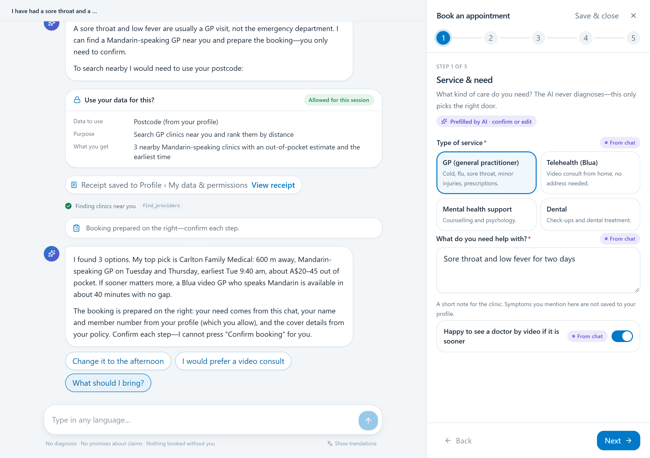
One request, a connected journey
AI Agent
Explain and prepare
Profile
Control permitted data use
Dashboard
Keep the result together
The Agent prepares. You review and submit. / Local prototype, fictional data.
08 / 14
Notes:
My Bupa Agent connects three places. The chat explains and prepares. Profile lets Lin control which information it can use. Dashboard holds her appointments and any health summary she allows. The Agent fills the form, and Lin reviews the details and submits it herself.
Pitch timing: 20 seconds.
[Sources]
Current project presentation plan and product definition, 28 September 2026. Prototype boundaries from README.md.
Screenshots captured from the local project prototype on 28 September 2026. Fictional member data and scripted behaviour.
[/Sources]

Slide 9
Trust grows through useful help
0
1
2
3
Translator
Form-filler
Assistant
Steward
Explain without
saving history
Prepare fields
for review
Reuse details
with permission
Offer reminders
the user chooses
Choose the level. Preview the benefit. Withdraw permission.
Proposed permission model
09 / 14
Notes:
Lin can begin with an explanation that saves no conversation history. When a useful task needs more information, she can choose to allow it. The proposed levels make those choices easier to understand. Moving up should follow a visible benefit, and moving down should stop the uses she no longer wants.
Full-deck / Q&A detail.
The four-level system is proposed. Revoking permission and deleting existing records are separate operations.
[Sources]
Current project presentation plan and product definition, 28 September 2026. Prototype boundaries from README.md.
[/Sources]

Slide 10
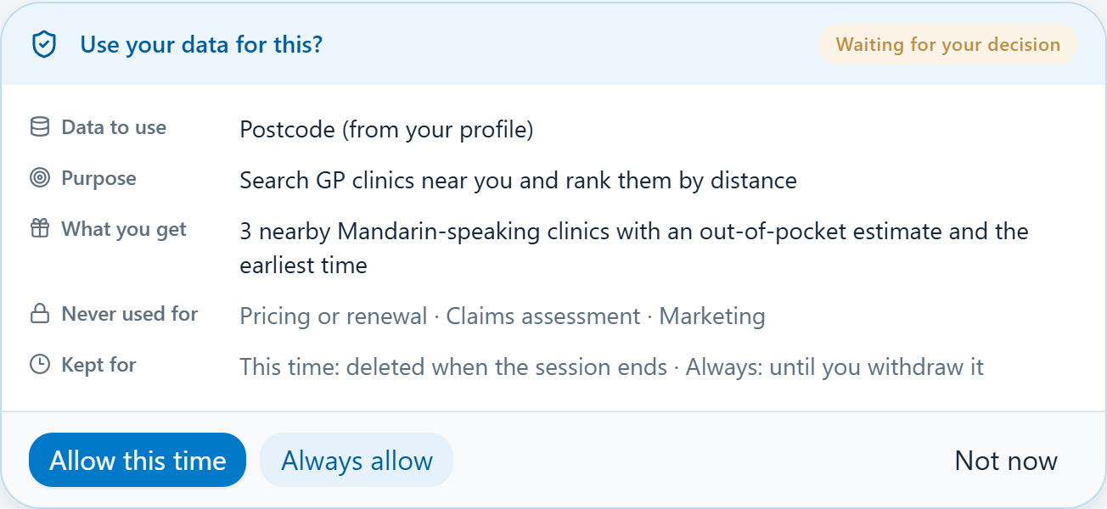
Lin’s first GP booking
Ask in Chinese
Understand the cover context
Share a postcode
A clear purpose and a choice
Review and submit
The appointment lands on Dashboard
Scripted demo. Fictional member, cover and clinic data.
10 / 14
Notes:
Lin asks in Chinese for help arranging a health check. The Agent explains the relevant cover and what still needs confirmation, then prepares the booking form. Here is the key moment: it asks for her postcode to find nearby clinics. She sees the purpose, chooses this time only, and gets relevant options. Each prefilled field shows its source. Lin checks the details and presses Submit herself. The appointment appears on Dashboard, and the permission receipt stays visible in Profile. All member and clinic information here is demo data.
Pitch timing: 50 seconds.
[Sources]
Current project presentation plan and product definition, 28 September 2026. Prototype boundaries from README.md.
General product background: https://www.bupa.com.au/health-insurance/oshc/cover/standard-oshc
Screenshots: local fictional prototype. Cover and provider amounts are demonstration data.
[/Sources]

Slide 11
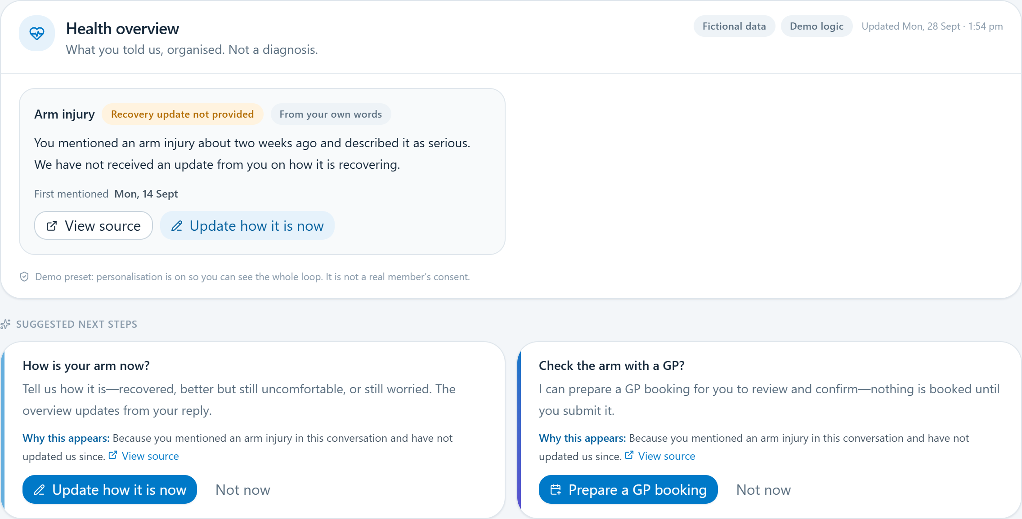
A useful next step,
with permission
Earlier
Lin permits a brief
visit summary.
Today
A suggestion explains
which information it uses.
Follow-up booking, if her doctor recommended it.
Concept walkthrough using the local prototype. Sharing remains optional.
11 / 14
Notes:
With separate permission, Lin can keep a brief record of her arm-injury visit. Later, a reminder explains why it appears and offers help if her doctor recommended follow-up. She can prepare another booking or dismiss it. She can also withdraw permission for future suggestions.
Pitch timing: 20 seconds.
Concept walkthrough. The local demo uses simulated history; do not imply production cloud memory or medical diagnosis. Follow-up is conditional on the clinician’s advice.
[Sources]
Current project presentation plan and product definition, 28 September 2026. Prototype boundaries from README.md.
Screenshots captured from the local project prototype on 28 September 2026. Fictional member data and scripted behaviour.
[/Sources]

Slide 12
Prototype scope
and production path
Prototype
Production path
Permissions
Booking preparation
Receipts
Approved integrations
Verified cover rules
Security review
Scripted responses. Fictional data.
Requires Bupa and provider agreement.
Production integration still required
12 / 14
Notes:
The prototype demonstrates the booking journey, permission controls and receipts using scripted responses and fictional data. Production would require approved Bupa and provider integrations, verified cover rules, and security review. The model would help interpret requests, while application code controls permissions and final submission.
Full-deck / Q&A detail.
[Sources]
Current project presentation plan and product definition, 28 September 2026. Prototype boundaries from README.md.
Screenshots captured from the local project prototype on 28 September 2026. Fictional member data and scripted behaviour.
[/Sources]

Slide 13
Value to test in a 90-day pilot
90
More completed bookings
Fewer avoidable support calls
Clearer cost expectations
days
More use of relevant services
One university intake
Proposed pilot outcomes
13 / 14
Notes:
We propose a 90-day pilot with one university intake. We would measure completed bookings, avoidable support contacts and members' understanding of costs. We would also check whether members understand their consent choices and can withdraw them easily. If the journey proves useful, Dashboard could support further services under the same permission model.
Full-deck / Q&A detail.
[Sources]
Current project presentation plan and product definition, 28 September 2026. Prototype boundaries from README.md.
[/Sources]

Slide 14
Helping Lin take
the next step
With her permission.
In her language.
My Bupa Agent
14 / 14
Notes:
Helping Lin take the next step. Thank you.
Pitch timing: 3 seconds.
Q&A: Distinguish scripted prototype from approved production integration. Consent withdrawal stops the relevant future use. Do not equate it with deleting all medical or transaction records. Measure task completion and informed consent as well as support contacts.
[Sources]
Current project presentation plan and product definition, 28 September 2026. Prototype boundaries from README.md.
Abstract background generated with the built-in imagegen tool. Prompt retained in .ppt-build/assets/blue-flow-prompt.txt.
[/Sources]

